Slide 1
Penalty in Logistic Regression

Slide 2
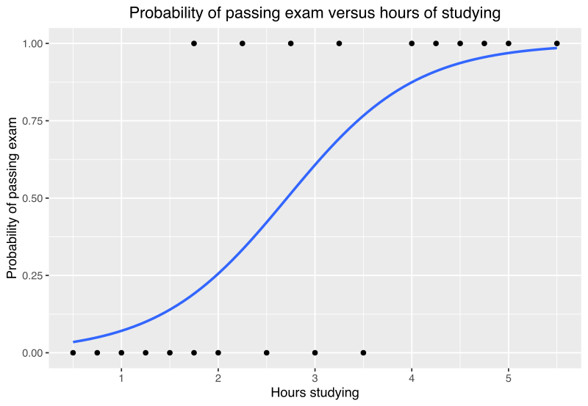
Logistic regression is a supervised machine learning algorithm, used -
for prediction and classification problems
when the dependent variable is categorical

Slide 3
Penalized logistic regression
When a model have multiple variables, it’s good to reduce some variables to enhance the performance of the model
A penalty is imposed to the model for having too many variables
This results in shrinking the coefficients of less contributing variables towards zero, known as Regularization
Most common penalized regression include:
Ridge regression (L2) —------ ∑(y - y^)2 + λ(m)2
Lasso regression (L1) —------ ∑(y - y^)2 + λ|m|
Elastic net regression —-------∑(λ*L1_penalty) + ((1 - λ) * L2_penalty)

